Slide 1

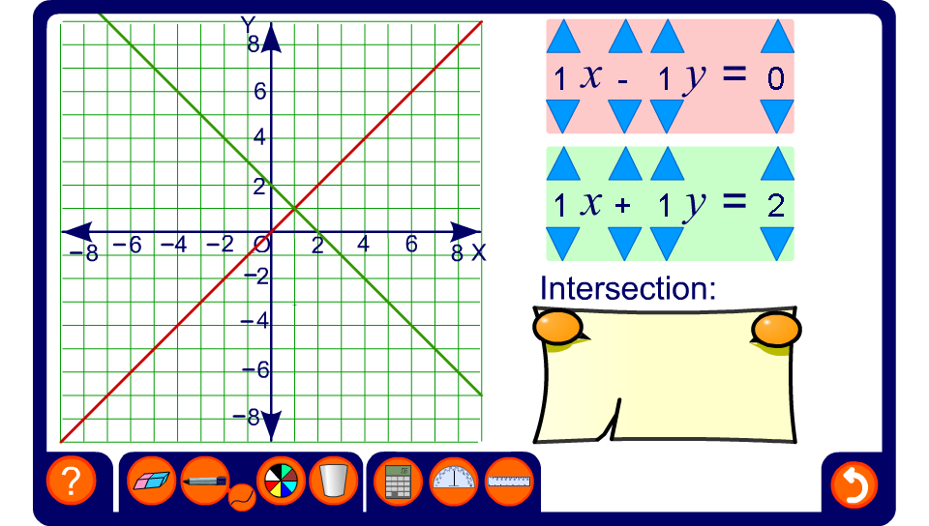


Solving simultaneous equations graphically
Notes:
Use this activity to demonstrate the solutions to linear simultaneous equations graphically.
Investigate examples where there are no solutions, that is, when the lines are parallel, and where there are infinite solutions, that is, when the lines coincide.
Point out that when the solution are not whole numbers, it can be difficult to find the solution exactly from a graph. For these problems an algebraic method is required.

